Slide 1
AUTOMATIC CLOTH COLLECTOR SYSTEM
PRESENTED By :
Balaji S (22AI003)
Naresh Kumar S (22AI027)
Srijith K (22AI051)
Guided By:
Dr. K. Lalitha,
Professor,
Dept of AI & DS.
TEAM NO: 03
22AIC14 : Internet of Things & It’s Application

Slide 2
Abstract
This project introduces a smart “Raindrop Sense and Cloth Collector System” utilizing an “ESP8266 microcontroller” and “servo motor”.
It automates the protection of clothes by detecting raindrops using a sensor and retracting the drying rack or deploying a cover.
The system restores the rack to its drying position when rain stops. With Wi-Fi capabilities, users can monitor and control the system remotely.
This cost-effective and energy-efficient solution ensures convenience and reliability, making it ideal for unpredictable weather conditions.

Slide 3
Objectives:
The objective of this project is to design an automated system that detects rain using a raindrop sensor and protects clothes by retracting the drying rack or deploying a cover.
The system leverages an ESP8266 microcontroller for processing and a servo motor for movement, ensuring a seamless response to changing weather conditions.
Additionally, it incorporates Wi-Fi connectivity, allowing users to remotely monitor and control the system via a smartphone or web application.
This solution aims to provide a cost-effective, energy-efficient, and convenient way to safeguard clothes while promoting smart IoT technology in everyday life.

Slide 4
Components Required:
ESP8266
Raindrop sensor
Breadboard Power Supply
Servo motor
Connecting wires
Power supply

Slide 5
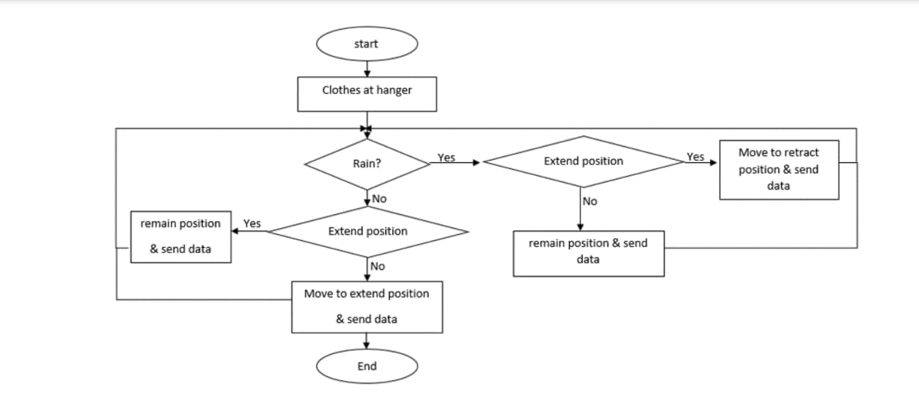
Flow Diagram:

Slide 6
Implementation:
Hardware:
Microcontroller: ESP8266
Servo Motor
Power Supply Board
Software:
Arduino IDE

Slide 7
Practical Usage:
Households: Automates protection of clothes drying outdoors, eliminating the need for constant weather monitoring.
Laundromats : Enhances efficiency in managing outdoor drying spaces by protecting clothes during rain.
Hostels and Apartments: Provides a shared solution for outdoor drying spaces, ensuring convenience for multiple users.
Rural Areas: Offers a simple, cost-effective way to protect clothes from rain in regions with limited infrastructure.
Weather-Intensive Regions: Ideal for areas with unpredictable rain, saving time and effort in managing outdoor drying.

Slide 8
Future Enhancement
Future enhancements to an automatic cloth collector system can focus on integrating smart technologies for better efficiency and user experience.
Adding weather sensors would allow automatic retraction of clothes during rain or harsh sunlight. A mobile app with remote control, alerts, and voice assistant compatibility can enhance convenience.
AI integration can optimize handling by detecting fabric types, while solar power can make the system energy-efficient.
Additional features like robotic folding for post-collection organization, anti-theft sensors for security, and a compact, modular design for small spaces would further improve functionality and usability.

Slide 9
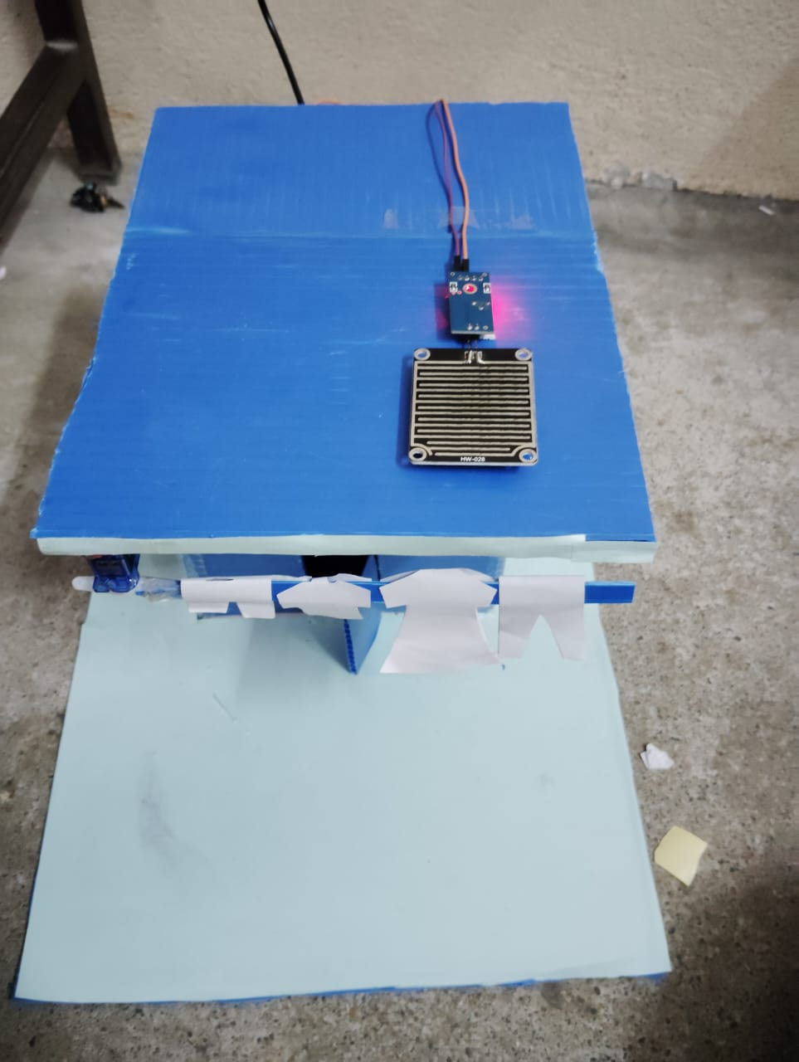
Screenshot

Slide 10
THANK YOU

